Slide 1
Student marks calculator app
BY
NAME: v.Satya raj
REGNO:192011269

Slide 2
AIM
Calculate the marks: write code to calculate the marks based on the formulas specified in the requirements.
Display the results: finally, display the results to the user in an easy-to-understand format.
Test the app: test the app thoroughly to ensure it is functioning correctly and meets the requirements.

Slide 3
ABSTRACT
The student mark calculator is a software tool designed to simplify the process of calculating and tracking the grades of students.
With this tool, teachers and instructors can easily input student marks for assignments, exams, and other assessments, and have the results calculated and organized in a user-friendly interface.
The calculator takes into account various grading systems, weighting, and other factors, and provides an accurate, up-to-date representation of each student's overall performance. this tool saves time, reduces the risk of errors, and helps educators make informed decisions about student performance.

Slide 4
introduction
A student marks calculator app is a mobile application that provides an easy and convenient way for teachers and instructors to calculate and track the grades of their students.
The app can also generate reports and analysis of student performance, helping teachers to monitor progress and identify areas where students may need additional support.
With its user-friendly interface and the ability to store and access student data on-the-go, the student marks calculator app is an essential tool for educators looking to streamline their grading process and enhance their students' learning experience.

Slide 5
ADVANTAGES
Time-saving: a marks calculator can calculate the marks of a large number of students in a matter of minutes, saving a lot of time compared to manual calculations.
Increased accuracy: a marks calculator reduces the chances of errors in calculation, providing more accurate results.
Convenient: a marks calculator is convenient to use and can be accessed from any device with an internet connection.
Easy to use: it is user-friendly and requires minimal technical knowledge to operate.

Slide 6
EXISITING WORK
Custom software: some schools and universities have developed custom software specifically designed to calculate student marks and grades.
These software programs often integrate with the school's existing systems and provide additional features such as reporting and data analysis.
Online calculator tools: there are various online student marks calculators available, which allow teachers to input marks.
Mobile apps: there are also several mobile apps available for students and teachers that provide a convenient platform for calculating and tracking marks.

Slide 7
PROPOSED WORK
Integration with learning management systems (lms): integrating the student marks calculator with an platform will allow teachers to easily track and manage student marks.
Advanced reporting: the calculator can generate reports and analytics on student performance, making it easier for teachers to evaluate and compare student progress over time.
User-friendly interface: the calculator should have a user-friendly interface that is easy to navigate, making it simple for teachers to input and access student marks.

Slide 8
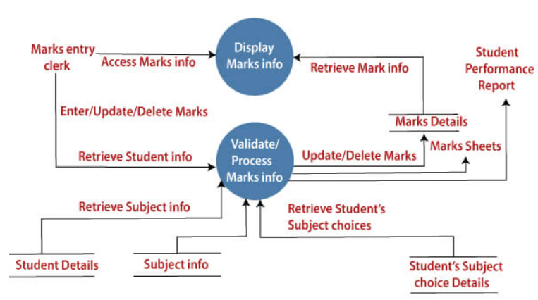
DATA FLOW DIAGRAM

Slide 9
1.Smartphone with android os version 4.4 (miui 12) or higher 2.Minimum 512 Gb of ram 3.A processor with speeds above 1.2 ghz (any make) 4.16 Gb of storage for the app and extra for the data stored, the size of the app increases as the number of entries are increased. 5.Android app version 19 . 6.Minimum of 5mb of storage space for application.
SOFTWARE & HARDWARE REQUIREMENT

Slide 10
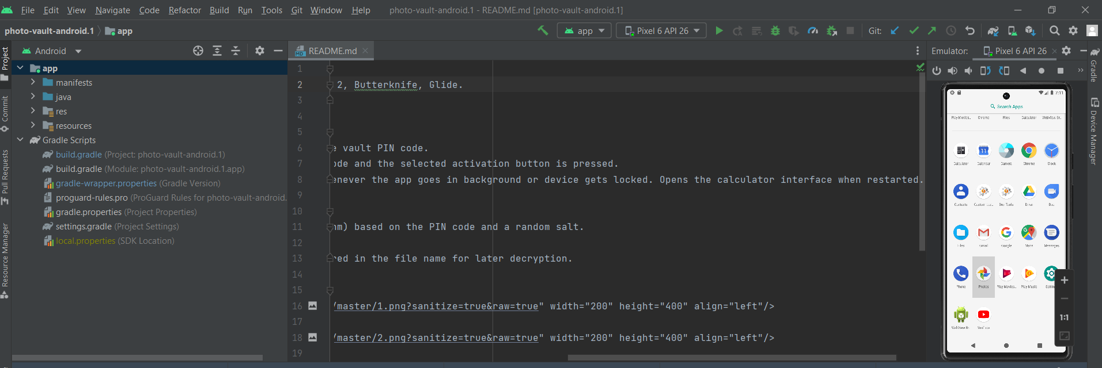
software or (android mobile )

Slide 11
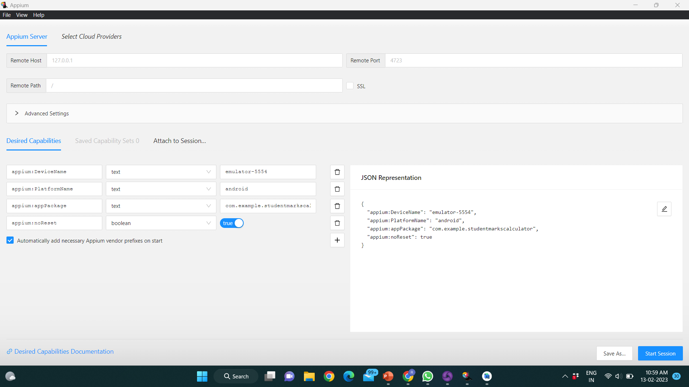
APPIUM INSPECTOR

Slide 12
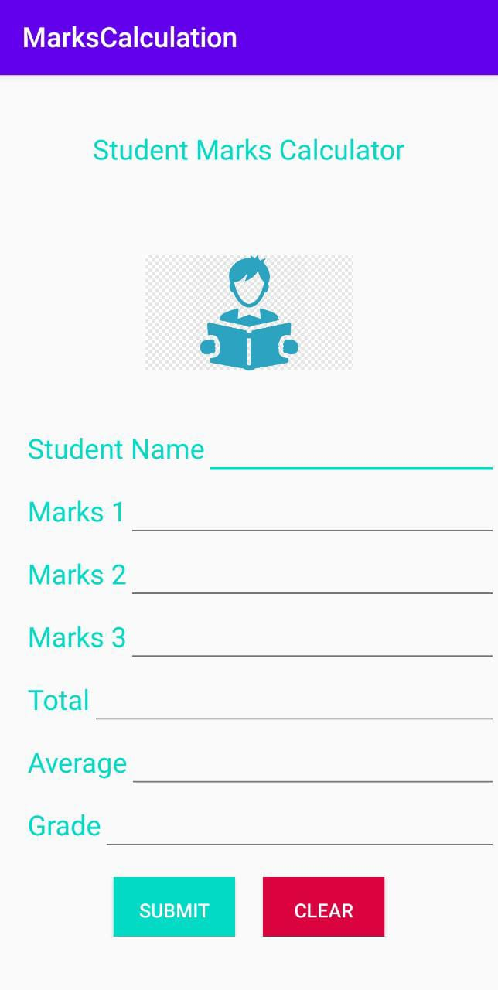
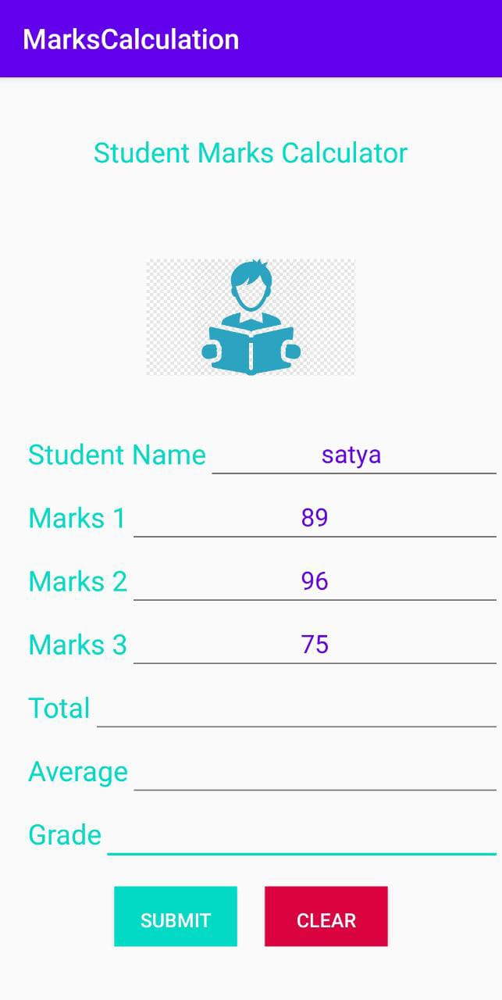
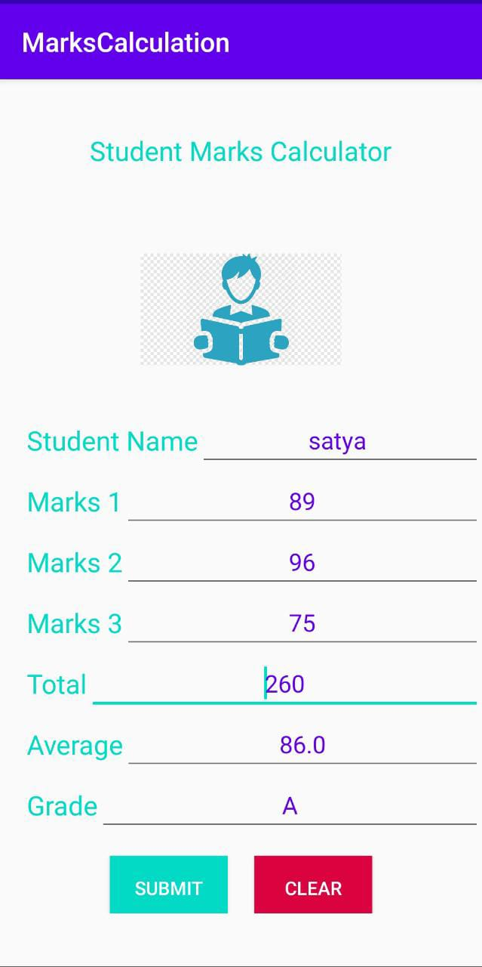
SCREENSHOT OF OUTPUT

Slide 13
CONCLUSION
A student marks calculator is a valuable tool for teachers, students, and educational institutions.
It helps to streamline the marking process and provides accurate and meaningful insights into student performance.
With features such as automated grading, personalized feedback, and advanced reporting, the student marks calculator can greatly improve the efficiency and effectiveness of the grading process.
The calculator can be customized to suit the specific needs of each teacher and educational institution, making it a flexible and scalable solution for managing student marks and grades.
By implementing a student marks calculator, teachers can spend more time focusing on teaching and engaging with students, and students can receive more meaningful feedback to help them succeed.

Slide 14
REFERENCES
Android. (2017). Android debug bridge (adb), android studio. Retrieved from https://developer.android.com/ studio/command-line/adb.html (Accessed: 2018-01-27)
AppBrain. (2018). Monetize, advertise and analyze android apps. Retrieved from http://www.Appbrain.com (Accessed: 2018-01-27)
Google. (2018). Google play store. Retrieved from http://www.Play.google.com (Accessed: 2018-01-27) Harris, R. (2006).
Arriving at an anti-forensics consensus: Examining how to define and control the anti-forensics problem. digital investigation, 3 , 44–49.
Jovanovic, Z., & Redd, I. (2012). Android forensics techniques. International Academy of Design and Technology. Lessard, J., & Kessler, G. (2010).
Android forensics: Simplifying cell phone examinations. Lohrum, M. (2018). Free android forensics. Retrieved from http://www.Freeandroidforensics .blogspot.com (Accessed: 2018-01-27)

Slide 15
THANK YOU

